Slide 1
STATISTICS

Slide 2
STATISTICS BASICS
The fundamental relationship of a Sample to a Population
Descriptive Statistics
Center and spread of the data
Outliers
Visualizations
Inferential Statistics: infer population parameters from sample parameters
Correlation & Causation
Linear Regression
Types of Distributions
Normal Distribution
Z-scores & Standard Normal Distribution
Central Limit Theorem

Slide 3
KEY CONCEPT: POPULATION VS.SAMPLE
Population: An entire group of people or objects of interest
Sample: A subset of the population. Hopefully representative of the population.
Samples are used because we can’t get the entire population, or it is too expensive to get.
Examples:
Population: All the data analysts in the world. Sample: all data analysts in Ohio
Population: All Major League Baseball players. Sample: Cleveland Guardians players
Think of some examples yourself and tell us about them

Slide 4
ARE THESE POPULATIONS OR SAMPLES?
1. A teacher gives an exam to their pupils. The teacher wants to summarize the results of the exam.
Population. The teacher is only interested in these specific pupils' scores and nobody else.
2. A researcher has recruited males aged 45 to 65 old for an exercise study to investigate risk markers for heart disease (e.g., cholesterol).
Sample. A researcher investigating health related issues will not simply be concerned with only
the participants of their study; they will want to show how their sample results can be
generalized to the whole population (in this case, all males aged 45 to 65 years old).
3. A census is taken every 10 years in the US to gather information on demographics, etc.
A census is close to a population but misses some people because it is difficult to find them.

Slide 5
KEY CONCEPT: SAMPLE BIAS
Sample Bias is a systematic misrepresentation of the population data and is to be avoided.
Examples:
Using temperatures in June to represent the entire year.
1948 Presidential election prediction based on a phone survey when many people did not have a phone
Statistical theory tells us survey answers are plus/minus 3% if there are 1100 respondents
Then why are election surveys so bad at predicting the winner? Answer: the answers to the surveys are from a biased set of respondents.
Think of some examples and share them.

Slide 6
EXTREME BIAS – SURVIVORSHIP BIAS
A famous case of "survivorship bias" happened during WWII. American bombers were suffering significant losses during missions over Germany.
The Air Force was deciding where to put more protective armor on the planes. They studied the damaged planes and found that the fuselage (body) had the most bullet holes. So, they decided that was the area that needed to be reinforced.
But a statistician, Abraham Wald, reasoned differently. He thought the sample of planes with fuselage holes were the ones that returned. The ones that didn’t return likely had bullet holes in a different place – the engine and wings.
The armor was installed over the engines. That increased the % of bombers that successfully returned.

Slide 7

DESCRIPTIVE STATISTICS
Techniques for summarizing a set of data
in ways that people can easily interpret.
Notes:
Instructor & producer(for technical issues) to stay available as ‘office hours’ for any questions.

Slide 8
TYPES OF DATA
Numerical variables
Example 1: The number of miles on the odometer of a car.
Example 2: The age of an insured customer.
Categorical variables are non-numeric.
Example 1: The make of a car (Chevy, Tesla, Ford, etc.)
Example 2: The age in groupings: (0-19, 20-39, 40-59, 60-79, 80+)
Example 3: Survey Scores (5/4/3/2/1). These are often treated as numeric.
Notes:
Bias: Want to measure the average height of an American male. Gather a lot of data (+1000 data points!). But….we’ve gone to the tryout basketball camps. This will not be a solid measurement of the height of a typical American male.

Slide 9
MEAN, MEDIAN, AND MODE IN DEPTH
Numeric values use Mean and Median as measures of “central tendency”.
However, if the goal is to measure the improvement in project time and the improvement is due to the large values being reduced, the median may not pick up the improvement. This is particularly true for small to medium sized data sets.
For this data, the median is the best measure of the “central tendency” because there are a few atypically large project times that greatly influence the mean.

Slide 10
MEAN, MEDIAN, AND MODE IN DEPTH
Categorical variables use the mode to describe “central tendency”.
The mode of the car companies is Audi. The mode of the survey is 2.
Brand
Audi
Audi
Audi
Audi
Audi
Audi
BMW
BMW
Porsche
VW
VW
VW
Mercedes
Mercedes
Strictly speaking, survey answers are categorical, but people often treat them as numbers and compute average scores.
Notes:
Workbook will show special cases using excel

Slide 11
MEAN, MEDIAN, AND MODE IN DEPTH – KHAN
Khan Academy
Statistics Intro: Mean, median, & mode
To access Khan Academy Lessons:
Control-Click the link to access the material everywhere in the presentation.
Notes:
https://www.khanacademy.org/math/statistics-probability/summarizing-quantitative-data/mean-median-basics/v/statistics-intro-mean-median-and-mode
Instructor & producer(for technical issues) to stay available as ‘office hours’ for any questions.

Slide 12
STANDARD DEVIATION IN DEPTH
The average is a measure of the “central tendency” of a set of data.
The standard deviation is a measure of how compact or spread-out the data is.
There are 2 Excel calculations, depending on if the data is a population or sample
(Population) Standard Deviation = stdev.p
Sample Standard Deviation = stdev.s
For theoretical reasons, stdev.s is generally a little larger than stdev.p.
STDEV ( ) uses stdev.s( ) to be conservative.

Slide 13
STANDARD DEVIATION IN DEPTH – KHAN
Khan Academy
Standard Deviation
Sample Standard Deviation
Notes:
https://www.khanacademy.org/math/statistics-probability/summarizing-quantitative-data/variance-standard-deviation-population/v/range-variance-and-standard-deviation-as-measures-of-dispersion
https://www.khanacademy.org/math/statistics-probability/summarizing-quantitative-data/variance-standard-deviation-sample/v/sample-variance
Instructor & producer(for technical issues) to stay available as ‘office hours’ for any questions.

Slide 14
DISPLAYING DATA
Khan Academy
Displaying & Describing
Notes:
https://www.khanacademy.org/math/ap-statistics/quantitative-data-ap
Instructor & producer(for technical issues) to stay available as ‘office hours’ for any questions.

Slide 15
OUTLIERS
Outliers are data values that are significantly different from the other values
Example: 0, 0, 1, 1, 2,100, 3, 2
Outliers can dramatically affect the calculations of x̅ and s.
with the outlier, x ̅ = ( 0+ 0 + 1 + 1 + 2 + 100 + 3 + 2) / 8 = 13.6
without the outlier, x ̅ = ( 0+ 0 + 1 + 1 + 2 + 3 + 2) / 7 = 1.3
You can only remove outliers if you have a valid reason. Example from Claims:
100 could represent the real # of cars involved in a pile up (keep it)
100 could be a “fat fingered” data error (change or remove it).
PGR Pricing Indications: we remove Large Losses initially, then redistribute them.
In practice, it is difficult to identify outliers in big datasets. Graphing might help..
Notes:
Excel file has examples.

Slide 16
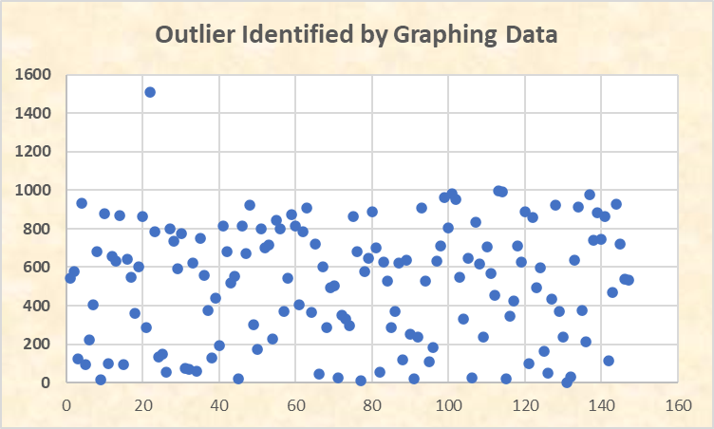
OUTLIERS
Notes:
Excel file has examples.

Slide 17
OUTLIERS– KHAN
Khan Academy
Outliers
Notes:
https://www.khanacademy.org/math/ap-statistics/summarizing-quantitative-data-ap/stats-box-whisker-plots/v/judging-outliers-in-a-dataset

